Slide 1

Web Analytics
Rui Gonçalves
ruiahgoncalves@gmail.com

Slide 2
Subject to be covered
The digital society as a global platform for Information exchange
Understand the role of the digital society today
See how analytics can bring value to organizations within the digital society
Realize what types and sources of data are available
Which analyzes can be applied
How can we evaluate the success of an analytical strategy applied to the digital society
Explore case studies about applying analytical strategies in different industries
Advanced topics: IoT and smart cities
2

Slide 3
Projected classes
# Class | Topic
1 | Main subject presentation; Evaluation, Classes
2 | Introduction to web analytics
3 | 4th revolution
4 | Topics on process and data
5 | Topic on analytics and algorithms
6 | How to evaluate a WA strategy: customer experience and others
7 | Student presentations
8 | Student presentations
9 | Successful companies and Amazon
10 | Case Studies: Medical, agriculture, planes and cars
11 | Case Studies: Elections, power and futebol
12 | Case Studies: fashion, hotels and sentimental
13 | Intelligent cities
14 | Student presentations
15 | Student presentations

Slide 4
Evaluation
One written test (25%) – At date set by NOVAIMS
two group presentations (75%):
Groups of 3,4 students
Presentation in classes and document (ppt or pdf) by email
Proposed dates 1st: 6 e 13 of April; 2nd: May, 25, Jun, 1
2

Slide 5
Introduction
The World Wide Web is an immense source of data that can come either from the Web content, represented by the billions of pages publicly available, or from the Web usage, represented by the log information daily collected by all the servers around the world. Web Mining is that area of Data Mining which deals with the extraction of interesting knowledge from the World Wide Web.

Slide 6
Introduction
Web mining can be broadly defined as the discovery and analysis of useful information from the World Wide Web. This describes the automatic search of information resources available on-line, i.e. Web content mining, and the discovery of user access patterns from Web servers, i.e., Web usage mining.

Slide 7
Web Analytics Taxonomy

Slide 8
Web Content Mining – Agent Based Approach
Intelligent Search Agents: Several intelligent Web agents have been developed that search for relevant information using domain characteristics and user profiles to organize and interpret the discovered information.
Information Filtering/Categorization: A number of Web agents use various information retrieval techniques and Characteristics of open hypertext Web documents to automatically retrieve, filter, and categorize them
Personalized Web Agents: This category of Web agents learn user preferences and discover Web information sources based on these preferences, and those of other individuals with similar interests (using collaborative filtering).

Slide 9
Web Content Mining – Database approach
Multilevel Databases: The main idea behind this approach is that the lowest level of the database contains semi-structured information stored in various Web repositories, such as hypertext documents.
Web Query Systems: Many Web-based query systems and languages utilize standard database query languages such as SQL, structural information about Web documents, and even natural language processing for the queries that are used in World Wide Web searches.

Slide 10
Web Usage Mining
Web usage mining is the automatic discovery of user access patterns from Web servers. Organizations collect large volumes of data in their daily operations, generated automatically by Web servers and collected in server access logs. Other sources of user information include referrer logs which contain information about the referring pages for each page reference, and user registration or survey data gathered via CGI scripts.
Pattern Discovery Tools. The emerging tools for user pattern discovery use sophisticated techniques from AI, data mining, psychology, and information theory, to mine for knowledge from collected data.
Pattern Analysis Tools. Once access patterns have been discovered, analysts need the appropriate tools and techniques to understand, visualize, and interpret these patterns

Slide 11
High level system architecture

Slide 12
High level system architecture
In the Business Data Definition component the e- commerce business user defines the data and metadata associated with their business. This data includes merchandising information (e.g., products, assortments, and price lists), content information (e.g., web page templates, articles, images, and multimedia) and business rules (e.g., personalized content rules, promotion rules, and rules for cross-sells and up-sells)

Slide 13
High level system architecture
The Customer Interaction component provides the interface between customers and the e-commerce business. The term customer interaction applies more generally to any sort of interaction with customers. This interaction could take place through a web site (e.g., a marketing site or a web store), customer service (via telephony or email), wireless application, or even a bricks-and-mortar point of sale system.

Slide 14
High level system architecture
The Analysis component provides an integrated environment for decision support utilizing data transformations, reporting, data mining algorithms, visualization, and OLAP tools. The richness of the available metadata gives the Analysis component significant ad- vantages over horizontal decision support tools, in both power and ease-of-use.

Slide 15
High level system architecture
The Stage Data bridge connects the Business Data Definition component to the Customer Interaction component. This bridge transfers (or stages) the data and metadata into the Customer Interaction component.

Slide 16
High level system architecture
The Build Data Warehouse bridge links the Customer Interaction component with the Analysis component. This bridge transfers the data collected within the Customer Interaction component to the Analysis component and builds a data warehouse for analysis purposes. The Build Data Warehouse bridge also transfers all of the business data defined within the Business Data Definition component (which was transferred to the Customer Interaction component using the Stage Data bridge).

Slide 17
High level system architecture
The last bridge, Deploy Results, is the key to “closing the loop” and making analytical results actionable. It provides the ability to transfer models, scores, results and new attributes constructed using data transformations back into the Business Data Definition and Customer Interaction components for use in business rules for personalization.

Slide 18
High level Web Mining Process

Slide 19
A General Architecture for Web Usage Mining
The architecture divides the Web usage mining process into two main parts:
The first part includes the domain dependent processes of transforming the Web data into suitable transaction form. This includes preprocessing, transaction identification, and data integration components.
The second part includes the largely domain independent application of generic data mining and pattern matching techniques (such as the discovery of association rule and sequential patterns) as part of the system’s data mining engine.

Slide 20
Data processing
The first preprocessing task is data cleaning
Elimination of irrelevant items can be reasonably accomplished by checking the sufix of the URL name. For instance, all log entries with filename suffixes such as, gif, jpeg, GIF, JPEG, jpg, JPG, and map can be removed.
A related but much harder problem is determining if there are important accesses that are not recorded in the access log. Mechanisms such as local caches and proxy servers can severely distort the overall picture of user traversals through a Web site.
Current methods to try to overcome this problem include the use of cookies, cache busting, and explicit user registration. Cookies can be deleted by the user, cache busting defeats the speed advantage that caching was created to provide and can be disabled, and user registration is voluntary and users often provide false information.

Slide 21
Data processing
Another problem associated with proxy servers is that of user identification. Use of a machine name to uniquely identify users can result in several users being erroneously grouped together as one user. heuristics involve using a combination of IP address, machine name, browser agent, and temporal information to identify users
The second major preprocessing task is transaction identification. Before any mining is done on Web usage data, sequences of page references must be grouped into logical units representing Web transactions or user sessions. Unlike traditional domains for data mining, such as point of sale data bases, there is no convenient method of clustering page references into transactions smaller than an entire user session.

Slide 22
Data processing
The second major preprocessing task is transaction identification. Before any mining is done on Web usage data, sequences of page references must be grouped into logical units representing Web transactions or user sessions.
A user session is all of the page references made by a user during a single visit to a site. Identifying user sessions is similar to the problem of identifying individual users, as discussed above.
A transaction differs from a user session in that the size of a transaction can range from a single page reference to all of the page references in a user session, depending on the criteria used to identify transactions.
Unlike traditional domains for data mining, such as point of sale data bases, there is no convenient method of clustering page references into transactions smaller than an entire user session.

Slide 23
Discovery Techniques
There are many different types of graphs that can be formed for performing path analysis, since a graph represents some relation defined on Web pages. The most obvious is a graph representing the physical layout of a Web site, with Web pages as nodes and hypertext links between pages as directed edges. Other graphs could be formed based on the types of Web pages with edges representing similarity between pages, or creating edges that give the number of users that go from one page to another.
Most of the work to date involves determining frequent traversal patterns or large reference sequences from the physical layout type of graph. Path analysis could be used to determine most frequently visited paths in a Web site. Other examples of information that can be discovered through path analysis are:
70% of clients who accessed /company/product2 did so by starting at /company and proceeding through /company/new, /company/products, and /company/product;
80%of clients who accessed the site started from /company/products; or
65% of clients left the site after four or less page references.

Slide 24
Discovery Techniques
Association rule discovery techniques are generally applied to databases of transactions where each transaction consists of a set of items. In such a framework the problem is to discover all associations and correlations among data items where the presence of one set of items in a transaction implies the presence of other items. In the context of Web usage mining, this problem amounts to discovering the correlations among references to various files available on the server by a given client. Each transaction is comprised of a set of URLs accessed by a client in one visit to the server. For example, using association rule discovery techniques we can find correlations such as the following:
40% of clients who accessed the Web page with URL /company/product1, also accessed /company/product2;or
30% of clients who accessed /company/special, placed an online order in /company/product.

Slide 25
Discovery Techniques
Discovering sequential patterns is to find inter-transaction patterns such that the presence of a set of items is followed by another item in the time-stamp ordered transaction set. In Web server transaction logs, a visit by a client is recorded over a period of time. The discovery of sequential patterns in Web server access logs allows Web-based organizations to predict user visit patterns and helps in targeting advertising aimed at groups of users based on these pat- terns. By analyzing this information, the Web mining system can determine temporal relationships among data items such as the following:
30% of clients who visited /company/products, had done a search in Yahoo, within the past week on keyword w; or
60% of clients who placed an online order in /company/product1, also placed an online order in /company/product4 within 15 days.

Slide 26
Discovery Techniques
Discovering classification rules allows one to develop a profile of items belonging to a particular group according to their common attributes. This profile can then be used to classify new data items that are added to the database. In Web usage mining, classification techniques allow one to develop a profile for clients who access particular server files based on demographic information available on those clients, or based on their access patterns. For example, classification on WWW access logs may lead to the discovery of relationships such as the following:
clients from state or government agencies who visit the site tend to be interested in the page /company/product I;or
50% of clients who placed an online order in /company/product2, were in the 20-25 age group and lived on the West Coast.

Slide 27
Discovery Techniques
Another important kind of data dependency that can be discovered, using the temporal characteristics of the data, are similar time sequences. For example, we may be interested in finding common characteristics of all clients that visited a particular file within the time period. Or, conversely, we may be interested in a time interval (within a day, or within a week, etc.) in which a particular file is most accessed.
Clustering analysis allows one to group together clients or data items that have similar characteristics. Clustering of client information or data items on Web transaction logs, can facilitate the development and execution of future marketing strategies, both online and off-line, such as automated re- turn mail to clients falling within a certain cluster, or dynamically changing a particular site for a client, on a return visit, based on past classification of that client.

Slide 28
Analysis of Discovered Patterns
The discovery of Web usage patterns, carried out by techniques described earlier, would not be very useful unless there were mechanisms and tools to help an analyst better understand them.
These techniques are expected to draw from a number of fields including statistics, graphics and visualization, usability analysis, and database querying.
Visualization has been used very successfully in helping people understand various kinds of phenomena, both real and abstract - The Web is visualized as a directed graph with cycles, where nodes are pages and edges are hyperlinks.
On-Line Analytical Processing (OLAP) is a powerful paradigm for strategic analysis of databases in business settings. The access information in server logs is modeled as an append-only history, which grows over time.

Slide 29
1º Team Assignment
Pick 2 online applications / sites, like for example facebook, twitter, whatsup, google, amazon, fnac, linkedin,….
From those applications / sites describe all the possibilities of data that you can remember thst you are able to retrive
Present ideas of knowledgr / information that you can build combine all that data
Build a 15m presentation with the following agenda:
Sites chossen, and the motivation for that
Data that can be retrived
Information that can be built

Slide 30
Internet of things
Reflections

Slide 31
Concept
The IoT is the connection of a multitude of devices to the Internet and each other. Beyond the obvious smartTVs and cars, devices that none of us thought needed any level of awareness will be installed with sensors ushering in the era of big data. The connections between these data streams and their analysis will allow for huge advances in intelligent systems.

Slide 32
Data
With more and more objects becoming connected both at work and at home, more and more data will flow from these simple systems into large databases from where correlations and decisions can be made. This will naturally reduce the need for human intervention. Whereas in the past you might have a lower level manager analyzing a set of data and then sending a report to his/her superiors, in the future the technology will do that without human participation.

Slide 33
Decision Making
We’ll see more hyper-localization like iBeacons, where a consumer gets messages to their phone depending on where they are in the store. With all the information that customers give to a retailer or consumer goods company about their habits and spending patterns, the technology will be able to make marketing decisions – without needing a marketing person to make them. So technology will change people and back office requirements alike.

Slide 34
Business Model
There will be dramatic effects in business-to-business companies too. The dynamics between buyers and suppliers will change – devices will automatically talk to each other when a product is running low, for example. There will be more automation around the tracking of an order and around the analysis of the quality and performance of parts and materials supplied.

Slide 35
New devices
We have devices with a real use-case which are connected to the internet now, like smartphones, cars, laptops and televisions. The IoT is all about connecting devices that have no use-case for connection to the internet, like your shoes, your carpet or light bulbs for example, and then finding a use for them through the fact that you’ve got a myriad of things in an intelligent network.

Slide 36
New devices
There will be a development in the way that devices are networked, and rather than connecting to a central point, they will link to each other, creating a stream of data from their various sensors. It is by the linking and cross-referencing of this data by intelligent applications that the IoT will be able to produce real change within our home or working environment.

Slide 37
New devices
For example, if you’ve installed a sound monitor in the light bulb sockets it will be able to tell if you are having an argument and adjust the mood lighting to try and calm things down. Equally the carpet might communicate with the doors, lights and radiators, to switch bulbs on and off, and move the heating grid around as you move from room to room.

Slide 38
New devices
We need to be wary of giving away too much too quickly, but in the same way as applying filters to a search on the internet, the more detailed information you give, the better the services provided will be. If you don’t let your smart fridge track what’s in there, it can’t know to alert you if you’re running low on milk. If you don’t let it know that you prefer fat-free, how can your supermarket supply you with the correct product?

Slide 39
New profiling
The nature of the personal data being collected will also change. It is not going to be specifically things like dates of birth or pin numbers, it will be the minutiae of your daily life. What toothpaste you use, your sleeping patterns or what brand of orange juice you prefer. Many people will be happy to hand over this information in return for the provision of services such as automatically topped up shopping lists or a pillow or bed that adjusts its settings as you sleep for example.

Slide 40
Data to Action
Wearable devices that give an indication of health, such as heart rate or cholesterol levels will give businesses the opportunity to suggest services in return, such as specific treatments or reduced price health insurance for example. Monitoring sufferers of chronic health conditions would also allow for an immediate response to any crisis. However, the question arises of how to secure this sensitive data and prevent it from being used against the individual.

Slide 41
Data to Action
Diet will be another area where the IoT has an enormous effect. Through sensors and tracking apps, individually tailored diet plans can be created. Imagine if a biosensor could detect that you are lacking in vitamin C or a pregnant woman is short on folic acid and then order more of a product via your internet-connected fridge.

Slide 42
A dark side
The widespread adoption of intelligent objects and infrastructure is a force for good, but it has a darker side. I fear that in the embrace of sophisticated innovations that are designed to make our lives more efficient and convenient, we will hand control of our personal information to big business and government.

Slide 43
A dark side
I wonder whether the implications are being properly thought through. Who will control and monitor the data collected by ubiquitous sensors found in buildings, lampposts, water pipes, cars and even in domestic appliances such as microwaves?

Slide 44
A dark side
Everything that defines us: our family and social networks, our health and financial data, our employment records – even our online conversations – will all be up for sale; all capable of being breached and spread, read by governments, insurers, employers… and criminals.
Our information will be packaged into products and services and sold for commercial advantage much in the same way that sub-prime mortgages were packaged into products and leveraged before 2008 to create massive profits for the banks.

Slide 45
A dark side
There are many arguments for connected data. For instance, health data analytics will very likely help to prevent diseases and spot symptoms of illness early. But what happens when the same data is used to set our health insurance premiums, to determine our suitability for loans to even feed into our potential employability? Will advancements in predictive science and the availability of data make our risks uninsurable?

Slide 46
A dark side
Criminals and terrorists will have immense opportunities thanks to greater interconnectivity. Just think of the possibilities for cyber terrorists and state-sponsored actors to attack ‘smart’ transport networks and infrastructure, including planes and trains. Anything in the domestic supply chain could also be exploited, from smart TVs to fridges

Slide 47
A dark side
It won’t be long before the IoT becomes more intrusive. It can already suggest what food you should eat and what routes you should run. Commercial interests will become stronger. Technologies, algorithms and devices will be commissioned and produced through corporate sponsorships, partnerships and alliances. Perhaps your fridge will only order products made by a partner brand for example, and deter you from ordering others.

Slide 48
A dark side
The Government will inevitably be slow to legislate around this, as it always lags behind in the regulation of new technology. But should there be legislation and regulation and who would it benefit? The Government could have interests of its own; for example, reducing obesity would significantly benefit the NHS so it would be in their interests if someone was blocked from buying chocolate or had to stick to their carefully monitored health and fitness regime – or be denied weight loss surgery or certain benefits.

Slide 49
A dark side
Insurance companies could become more intrusive. Health insurance dependent on keeping to a certain regime, or car insurance dependent on following a specific route from A to B. They can already fit black boxes into cars to monitor driving behaviors. A phone insurer, meanwhile, may refuse to cover your phone if you regularly walk through ‘dangerous’ areas – picked up by GPS on the device. They’d argue the consumer has a choice, to buy more expensive insurance or change their behavior.

Slide 50
Case Studies

Slide 51
Mining Web Access Logs of an On-line Newspaper

Slide 52
Web Mining
Web Mining can be broadly categorized into three areas:
web content mining - focuses on techniques for searching the web for documents whose content meets web users queries.
Web structure mining is related to the analysis of the link structure of the web, in order to identify relevant documents.
Web usage mining is defined as the process of applying data mining techniques to the discovery of usage patterns from web logs data, to identify web users behavior

Slide 53
Data
Web server logs explicitly records browsing behavior of site visitors
Client-side data collection can be implemented by using a remote agent or by modifying the source code of an existing browser
Web proxies act as an intermediate level of caching between client browsers and Web servers.

Slide 54
Data
The information provided by the data sources described above can be used to construct several data abstractions:
A user is defined as a single individual that is accessing file Web servers through a browser. In practice, it is very difficult to uniquely and repeatedly identify users. A user may access the Web through different machines, or use more than one browser at one time.
A page-view consists of every file that contributes to the display on a user’s browser at one time and is usually associated with a single user action such as a mouse-click.
A click-stream is a sequential series of page-views requests. Note that any page view accessed through a client or proxy-level cache will not be recorded on the server side.
A server session (or visit) is the click-stream for a single user for a particular Web site. The end of a server session is defined as the point when the user’s browsing session at that site has ended.

Slide 55
Process – 3 phases
Preprocessing consists of converting usage information contained in the various available data sources into the data abstractions necessary for pattern discovery.
Another task is the treatment of outliers, errors, and incomplete data that can easily occur due reasons inherent to web browsing. The data recorded in server logs reflects the (possibly concurrent) access of a Web site by multiple users, and only the IP address, agent, and server side click-stream are available to identify users and server sessions. However, it is important to notice that the data collected by server logs may not be entirely reliable because some page views may be cached by the user’s browser or by a proxy server. In a Web server log, all requests from a proxy server have the same identifier, even though the requests potentially represent more than one user.
Also, due to proxy server level caching, multiple users throughout an extended period of time could actually view a single request from the server. The Web server can also store other kinds of usage information such as cookies, which are markers generated by the Web server for individual client browsers to automatically track the site visitors.

Slide 56
Process - 3 phases
The next phase is the pattern discovery phase. Methods and algorithms used in this phase have been developed from several fields such as statistics, machine learning, and databases. This phase of Web usage mining has three main operations of interest: association (i.e. which pages tend to be accessed together), clustering (i.e. finding groups of users, transactions, pages, etc.), and sequential analysis (the order in which web pages tend to be accessed). The first two are the focus of our ongoing work.
Pattern analysis is the last phase in the overall process of Web usage mining. In this phase the motivation is to filter out uninteresting rules or patterns found in the previous phase. Visualization techniques are useful to help application domains expert analyze the discovered patterns.

Slide 57
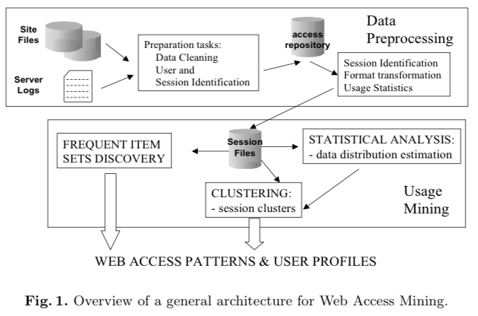
Access Logs Processing Architecture

Slide 58
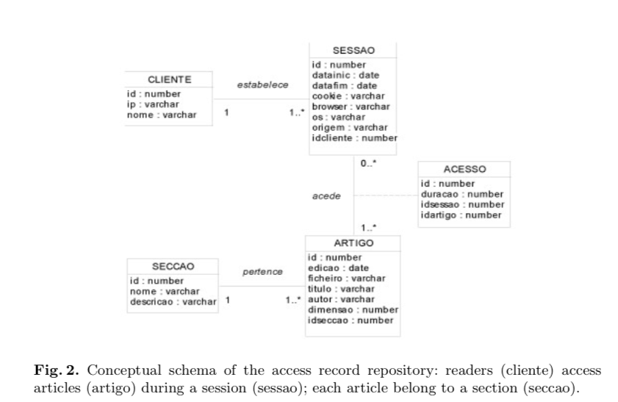
Data Model Layout

Slide 59
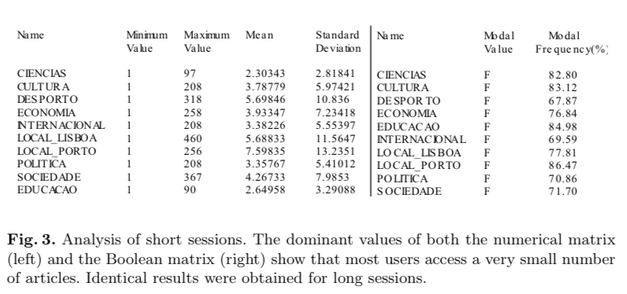
Basic statistical analysis

Slide 60
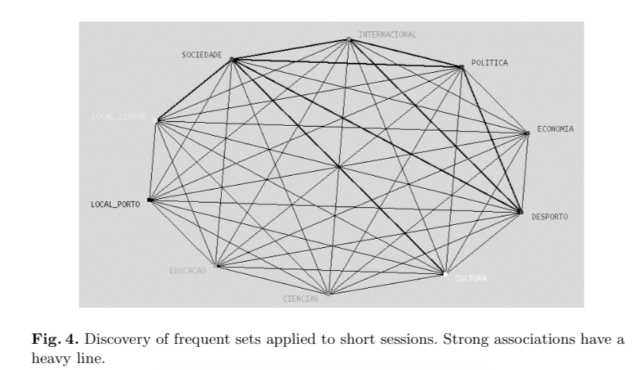
Discovering Frequent Associations

Slide 61
Some results
Strong associations between:
Politics (Politica) and Society (Sociedade),
Politics (Politica) and International News (Internacional)
Society (Sociedade) and International News (Internacional)

Slide 62
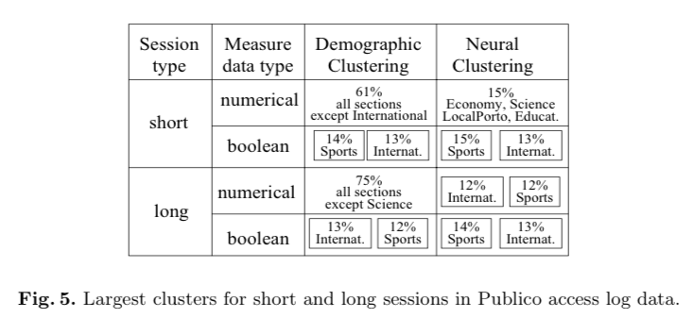
Clusters

Slide 63
Amazon

Slide 64
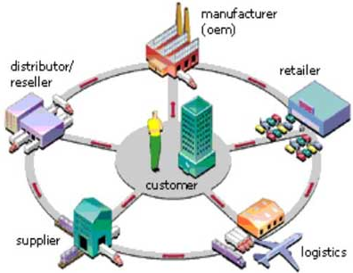
Amazon
21 data science systems used by Amazon to operate its business

Slide 65
Amazon
Supply chain optimization (I). Sites selection for warehouses to minimize distribution costs (proximity to vendors, balanced against proximity to consumers). How many warehouses are needed, and what capacity each of them should have.
Supply chain optimization (II). Selection of optimal routes, schedules, and products groupings, to minimize delivery costs (using graph theory)
Supply chain optimization (III). Optimization of gas purchases for delivery trucks.
Supply chain optimization (IV). Minimize time spent by drivers in traffic jams (requires traffic prediction) while optimizing delivery speed, gas usage and other factors (better be stuck 20 minutes in a traffic jam than a costly detour, or departing later?)

Slide 66
Amazon
Pricing and profit optimization (per-product price elasticity studies needed; may require products to be aggregated in categories, to create buckets that yield statistical significance)
Fraud detection for credit card transactions (use decision tree methods). Also detect criminal behavior taking place on AWS for instance. Detect system intrusions and hacking attempts (to prevent stealing data such as credit card data, or prevent employee ID theft, or other malicious activity).

Slide 67
Amazon
Fake reviews detection. They still have tons of progress to make in this area: at least categorizing users would be a first step, so that buyers know what kind of user produced a specific review; then relevancy algorithms must be used to assess how relevant a review is for a specific product, knowing that most likes and stars assigned by users are biased - partly because most normal people don't have time or interest to write a review. Indeed, fake reviews is a lucrative business taking advantages of inefficiencies in platforms such as Amazon. The best solution is to remove user-generated reviews and replace them, for each product, by number of sales over the last 30 days.
Taxonomy creation to categorize products, produce and maintain great catalogs, and help with user searches: this is a gigantic clustering problem, that can be done efficiently using tagging and indexing algorithms

Slide 68
Amazon
Smart search engine technology (based also on taxonomy discussed above) to help users find what they want to buy quickly
Multivariate testing, for instance to find out which version of a search engine increases sales, everything else being constant
Recommendation engine (and detection of artificial purchases aimed at fooling these algorithms)
Customer segmentation, churn analysis, using survival analysis models, to increase marketing and advertising efficiency

Slide 69
Amazon
Advertising optimization, including automated bidding on Google Adwords for millions of keywords in real time, most having no historical data (use bucketasition techniques to group keywords in buckets that have real predictive power); algorithms to identify millions of keywords worth purchasing, based on expected yield. Advertising mix optimization and attribution modeling. SEO and SEM.
Inventory forecasting: how many copies of each product should they keep at anytime in any warehouse, to optimize a few metrics (profit, product decay if perishable, delivery time etc.)
Sales forecasting broken down by category / location based on tons of factors that need to be identified first, using feature selection algorithms (including economic forecasts; requires time series techniques)

Slide 70
Amazon
HR analytics: who to hire, how to score candidates to better predict who will succeed; detect employees at risk of leaving or committing fraud; optimize purchase of office supplies; optimize employee compensation given several market constraints; optimize travel expenses
Real estate analytics
Software/hardware system analytics: minimizing/predicting server crashes, optimizing redundancy with budget constraints, optimizing load balance and bandwidth usage; how many servers must be purchased, how frequently should they be replaced. Also, create email alert systems, automatically prioritize messages and select recipients. Also manage external email campaigns (delivery rate, open and click rate optimization).

Slide 71
Amazon
Payments analytics. Optimization of payments: to authors, vendors, publishers, while maximizing profits and minimizing publisher / author / vendor churn; vendor and publisher selection algorithms.
Competitive analysis: automatically process billions of comments posted by users on social networks about Amazon, its competitors, and new trends; summarize this data, take actions based on the insights derived from this daily / hourly / real-time, automated analyses
Tax engineering

Slide 72
Brazilian Elections

Slide 73
Elections
Social networks, in one form or another, have existed since people first began to interact. Indeed, put two or more people together and you have the foundation of a social network. It is therefore no surprise that, in today’s Internet-everywhere world, online social networks have become entirely ubiquitous.
Within this world of online social networks, a particularly fascinating phenomenon of the past decade has been the explosive growth of Twitter, often described as “the SMS of the Internet”. Launched in 2006, Twitter rapidly gained global popularity and has become one of the ten most visited websites in the world. As of May 2015, Twitter boasts 302 million active users who are collectively producing 500 million Tweets per day. And these numbers are continually growing.
Given this enormous volume of social media data, analysts have come to recognize Twitter as a virtual treasure trove of information for data mining, social network analysis, and information for sensing public opinion trends and groundswells of support for (or opposition to) various political and social initiatives.Twitter Trend Topics in particular are becoming increasingly recognized as a valuable proxy for measuring public opinion.

Slide 74
Elections
General presidential elections were held in Brazil on October 5, 2014. No candidate received more than 50% of the vote, so a second runoff election was held on October 26th. In the first round, Dilma Rousseff (Partido dos Trabalhadores) won 41.6% of the vote, ahead of Aécio Neves(Partido da Social Democracia Brasileira) with 33.6%, and Marina Silva (Partido Socialista Brasileiro) with 21.3%. Rousseff and Neves contested the runoff on October 26th with Rousseff being re-elected by a narrow margin, 51.6% to Neves’ 48.4%. The analysis in this article relates specifically to the October 26th runoff election. Partido dos Trabalhadores (PT) is one of the biggest political parties in Brazil. It is the political party for the current and former presidents, Dilma Roussef and Luis Inacio Lula da Silva. Partido da Social Democracia Brasileira (PSDB) is the political party of the prior president Fernando Henrique Cardoso.
Began social media data mining by extracting Twitter Trend Topic data for the 14 Brazilian cities for which data is supplied via the Twitter API, namely: Brasília, Belém, Belo Horizonte, Curitiba, Porto Alegre, Recife, Rio de Janeiro, Salvador, São Paulo, Campinas, Fortaleza, Goiânia, Manaus, and São Luis.
Queried the Twitter REST API to get the top 10 Twitter Trend Topics for these 14 cities in a 20 minute interval (limited by some restrictions that Twitter has on its API). Limiting the query to these 14 cities is done by specifying their Yahoo! GeoPlanet WOEIDs (Where On Earth IDs).

Slide 75
Elections
Social Network Theory is the study of how people, organizations, or groups interact with others inside their network. There are three primary types of social networks:
Egocentric networks are connected with a single node or individual (e.g., you and all your friends and relatives).
Socio-centric networks are closed networks by default. Two commonly-used examples of this type of network are children in a classroom or workers inside an organization.
Open system networks are networks where the boundary lines are not clearly defined, which makes this type of network typically the most difficult to study. The type of socio-political network we are analyzing in this article is an example of an open system network.
Social network analysis examines the structure of relationships between social entities. These entities are often people, but may also be social groups, political organizations, financial networks, residents of a community, citizens of a country, and so on. The empirical study of networks has played a central role in social science, and many of the mathematical and statistical tools used for studying networks were first developed in sociology.
To create a network using the Twitter Trend Topics, I defined the following rules:
Each city is a vertex (i.e., node) in the network.
If there is at least one common trend topic between two cities, there is an edge (i.e., link) between those cities.
Each edge is weighted according to the number of trend topics in common between those two cities (i.e., the more trend topics two cities have in common, the heavier the weight that is attributed to the link between them).

Slide 76
Elections
For example, on October 26th, the cities of Fortaleza and Campinas had 11 trend topics in common, so the network for that day includes an edge between Fortaleza and Campinas with a weight of 11:
In addition, to aid the process of weighting the relationships between the cities, it was also considered topics that were not related to the election itself (the premise being that cities that share other common priorities and interests may be more inclined to share the same political leanings). Although the order of the trend topics could potentially have some significance to the analysis, for purposes of simplification of the proof-of-concept, it was chosen to ignore the ordering of the topics in the trend topic list.

Slide 77
Elections
Network topology is essentially the arrangement of the various elements (links, nodes, etc.) of a network. For the social network we are analyzing, the network topology does not change dramatically across the 3 days, since the nodes of the network (i.e., the 14 cities) remain fixed. However, differences can be detected in the weights of the links between the nodes, since the number of common trend topics between cities varies across the 3 days, as shown in the comparison below of the network topology on Day 24 vs. Day 25.

Slide 78
Elections
To assist in predicting election results, we consider not only the trend topics in common between cities, but also how the content of those topics relates to likely support for each of the two principal political parties; i.e., Partido dos Trabalhadores (PT) and Partido da Social Democracia Brasileira (PSDB).
First, created a list of words and phrases perceived to indicate a positive leaning toward, or support for, one of the parties. (Populating this list is admittedly a highly complex task. In the context of this proof of concept, I deliberately took a simplified approach. If anything, this makes the caliber of the results all the more intriguing, since a more highly tuned list of terms and phrases would presumably further improve the accuracy of the results.)
Then, for each node, count:
the number of its links which include terms that indicated support for PT
the number of its links which include terms that indicated support for PSDB
Using the city of Fortazela again as an example, I ended up with counts of:
Fortaleza['PT'] = 56 Fortaleza['PDSB'] = 37
We thereby draw the conclusion that Fortaleza residents have an overall preference for Partido dos Trabalhadores (PT).

Slide 79
Elections
Here are a few metrics, for example, that could be used to infer a node’s importance or influence, which could in turn inform the type of predictive analysis described in this article:
Node centrality. Numerous node centrality measures exist that can be employed to help identify the most important or influential nodes in a network. Betweenness centrality, for example, considers a node highly important if it forms bridges between many other nodes. The eigenvalue centrality, on the other hand, based a node’s importance on the number of other highly important nodes that link to it.
Clustering coefficient. The clustering coefficient of a node measures the extent to which a node’s “neighbors” are connected to one other. This is another measure that can be relevant to evaluating a node’s presumed degree of influence on its neighboring nodes.
Degree centrality. Degree centrality is based on the number of links (i.e., connections) to a node. This is one of the simplest measures of a node’s “significance” within a network.

Slide 80
Elections
Based on this algorithm, the analysis yields results that are surprisingly similar to the actual election results, especially when one considers the general simplicity of our approach. Here’s a comparison of the predictive results based on the Twitter Trend Topic data as compared with the real election results (red is used to represent Partido dos Trabalhadores and blue is used to represent Partido da Social Democracia Brasileira):

Slide 81
Soccer big data

Slide 82
World of soccer
Athletes are not only monitored by cameras on stadiums, but also by many quirky devices such as accelerometers, heart rate sensors and even local GPS-like systems. Indeed, Big Data and modern technologies are currently revolutionizing sports and even powering the Fantasy Sports industry.
Sports clubs, media outlets and fans around the world all share a thirst for advanced statistics and information. Big clubs use them to improve the performance of their own players, prepare tactics against other teams or scout potentially interesting players. On the other hand, media outlets love data just as much since it gives added value to their reports. Finally, the stats have also outsized importance for fantasy sports managers who create their fantasy teams with individual athletes in top form.
Let’s start with last year’s soccer World Cup in Brazil. While their last FIFA World Cup success can be attributed to many things, the Germans, known for technological know-how, had a trump card in their hands. Many soccer fans raised their eyebrows when it was revealed that the national squad wore Adidas’ miCoach elite team system during training sessions before and during the competition. The physiological monitoring service collects and transmits information directly from the athlete’s bodies, including heart rate, distance, speed, acceleration and power, and then display those metrics live on an iPad. All this information is made available live on an iPad to coaches and trainers on the sideline during training, as well as post-session for in-depth analysis. Interestingly enough, analysis of the data can help identify the fit players from those who could use a rest.

Slide 83
World of soccer
Of course, MiCoach is not the only device of this kind on the market. The major player is actually Australian company Catapult Sports, focused on Global Navigation Satellite System (GNSS) data, which is increasingly important to sports scientists and coaches, who monitor it to measure player movement and fatigue. As you have likely guessed, the tracking devices rely on GNSS satellites.
However, they also have their own local positioning system, ClearSky, which can be installed around the indoor area of the stadium when obstacles, like a closed roof, interfere with the ability to lock on to individual units. ClearSky uses anchor nodes to track players’ movements, while the devices with transmitters are worn at the top of the back, held in place by a compression shirt that looks a bit like a sports bra and can be worn over or under the uniform.
Another pioneer of wearable tracking devices is GPSport, acquired by Catapult Sports in July, known for its sophisticated performance-monitoring devices that incorporate advanced GPS tracking with heart rate. The combined group now works with more than 450 teams worldwide, including Chelsea, Real Madrid and Brazilian national team.
All these tracking devices fall under the Electronic Performance and Tracking System (EPTS) category. Until mid-2015, soccer players were allowed to wear them only during training. However, on July 7, the international governing body of soccer FIFA issued a memorandum announcing the approval of wearable electronic performance and tracking systems in matches – on the condition that they do not endanger player safety and that information is not available to coaches during matches.

Slide 84
World of soccer
FIFA has already made a step forward to control the use of these tools for its own competitions. After suffering several concussions, U.S. soccer veteran Ali Krieger chose to wear performance protection headgear from FIFA-approved Unequal Technologies during this month’s women’s soccer tournament in Canada. Unequal Halo, which looks similar to Petr Cech’s famous black protective helmet, combines Kevlar, high-tensile strain fibres and an Accelleron composite for ballistic-strength protection against concussions. So when force hits the 10-millimetres-thick Halo, instead of pinpointing directly into the head at the point of impact, it disperses the energy throughout the entirety of the headband.
Going back to soccer data, FIFA relies on a visual-tracking technology called Matrics to provide extensive data set in real time that makes up the on-site heat maps, passes completed and distance covered. The company behind Matrics is an Italian firm called Deltatre that uses several technologies and manual inputs from a large crew to deliver the real-time stats. This technology has been around for years, but it’s becoming more diverse, detailed and accurate.
Deltatre has also been appointed by UEFA to provide a number of services from each Champions League venue. These include on-air graphics generation, which is directly embedded into the multilateral feed, and data capture for UEFA’s official results system, produced using a combination of a player tracking system and dedicated in-venue spotters. On UEFA’s website one can find a comprehensive list of stats for players, clubs, groups, matches and goal times.

Slide 85
World of soccer
FIFA also collaborates with Infostrada, which delivers live-match coverage (streaming) services, and develops and calculates a World Ranking for the women’s national teams associated with FIFA’s competitions. Apart from Deltratre and Infostrada, sports data markets have other big players. One of them is ChyronHego, mostly known for its player-tracking technology TRACAB, which uses advanced patented image processing technology to identify the position and speed of all moving objects within each soccer arena. At 25 times per second, the system generates live, accurate X, Y and Z coordinates for every viewable object, including players, referees and even the ball. The data provides insight for coaches to evaluate player performance and track metrics such as distance run, speeds, stamina, pass completion, team formations, etc. TRACAB is installed in over 125 stadiums and is used in more than 2,000 matches per year by the Premier League, Bundesliga and Spanish La Liga.
ChyronHego has an agreement with Bundesliga, while Premier League’s first sports technology partner is EA Sports. The official data provider for the French Ligue 1 is Prozone (acquired by U.S.-based competitor Stats LLC in May 2015), which has a product that works in a similar way to TRACAB. Using around 10 cameras, the programme creates a two-dimensional animation of the playing field and is capable of registering 3,000 touches of the ball per game. It offers real-time, post-match and opposition analysis, and now most of Premier League teams use the system.

Slide 86
World of soccer
Many soccer leagues and clubs also collaborate with Opta, the leading provider of soccer sports data. Opta’s analytics can determine every single action of a player in a specific zone on the field, regardless of whether he has a ball or not. It can also measure the distance the player runs during the course of a game. There are more than 100 match-specific statistic categories, for instance shots, goals, assists, yellow and red cards, won and lost duels and also some lesser-known categories, such as accurate corners into box, effective blocked cross or accurate keeper throws.
This type of analytics is useful for clubs when scouting and to help shape roster development decisions. Probably, the most known supporter of this approach among the top managers is Arsene Wenger. The Arsenal manager once said that the personal touch in player scouting remains decisive, but the computer-generated statistics can certainly help his management to find a player they need. Not surprisingly, back in 2012, the English club even bought U.S.-based data company StatDNA that provides expert analysis, guiding everything from identifying new players to post-game tactical analysis.
Moreover, the stats are also used by betting companies (William Hill embed Opta’s regular contextual facts directly within its betting platform, while SkyBet uses them to add detail and colour to its regular email marketing communications), and more recently, Daily Fantasy Sports (DFS) operators. Sports data is used in two ways: firstly, companies use it to form scoring systems, and secondly, it’s a must for fantasy players who have to study many pieces of information in order to be successful fantasy sports managers. The more information they have, given the ability to dissect it, the higher are the chances to enhance the competitiveness.

Slide 87
World of soccer
Fantasy football (soccer) operators usually form partnerships with sports data companies, and use a limited number of stats, normally from five to 20, to sum up a game. However, there is one company whose scoring system proves the most advanced. Malta-based company Oulala Games Ltd has built a mathematical matrix that uses Opta’s data to create an efficient scoring system. This company’s platform uses a highly sophisticated algorithm to assess the crucial aspects of an athlete’s performance that contribute to an overall result. Their system includes a total of 70 different criteria dependent on a player’s position (keeper, defender, midfielder and striker) resulting in a total of 275 ways to gain or lose points. The aggregated numbers of these actions, made by players who are included in virtual teams, give the overall winners of different daily leagues.
Despite the fact that a high level of skill is required to become a league’s winner, some professional DFS players, especially in the U.S., have found a bypass that gives them a substantial edge over their competition – They are using advanced software known as scripting, which helps them to decide which players to pick, and in many cases, automatically enter hundreds of line-ups in multi-entry guaranteed prize pool (GPP) contests. Currently, all major DFS operators allow the practice.
Soccer, which has always been a numbers game, is apparently driven by more and more Big Data. Clubs are now likely hiring fewer scouts and more computer analysts; TV, radio and newspapers drive more stats-based conversation about the performance of players, managers and teams than ever before. Numbers are also seeping out of real soccer and into the fantasy – the stats that surround players are not only used to measure their actual performance, but also to evaluate their contribution to fantasy soccer teams. It’s fair to say that this Big Data revolution in soccer will only continue and change the whole experience of watching the most popular sport in the world.

Slide 88
Wearable devices

Slide 89
Wearable Technology
Do you remember Captain James Kirk using his wrist watch to communicate with the crew of the Starship Enterprise back in 1966? Today, almost after 50 years, it has finally become a reality!
Digital disruption is occurring in all business functions all around the world. Wearables are becoming mainstream and disrupting almost every industry, with the biggest impact being seen in customer service, healthcare and manufacturing.
Wearables currently stand at the stage where smartphones were back in 2007. Apple had just launched iPhone and the App store, but nobody could envision the vast range of applications that would soon become available. At that point, the iPhone was just considered to be a better phone, a music repository and a way to browse the web.
Today, wearables come in various forms, like smart watches, health trackers, Google Glass, interactive clothing, gesture controllers and list goes on. With wearables, we can enter into an exciting new realm of augmented reality, with an enhanced experience of what we see, hear and touch.
Insurers are using wearables like Google Glass to record claims information in the field in order to process them faster.
In healthcare, implanted bio sensors can capture and transmit health data, from heart rate and blood oxygen levels, to glucose sensors — to help identify risks and make diagnoses.
Smart watches can alert users when their blood sugar is low or if they have an irregular heartbeat. With wearables, anyone can carry a personal trainer on their body at all times.

Slide 90
Wearable Technology
Here are some other examples of wearables in our lives today:
ADAMM is a wearable technology that provides a complete solution for managing your asthma. It collects data on cough counting, respiration and heart rate, along with medication reminders provided in an app or online portal for accessing your daily status from anywhere.
If you or someone you know suffers from lower back pain, Valedo may be a solution. The device attaches to a person’s back and uses smart sensors that communicate with a companion app to guide the user through a series of therapeutic exercises.
Helius by Proteus Digital Health is the first-ever digestible microchip, and is used to detect when a patient takes their medication. The data is transmitted to a companion app, enabling doctors and caregivers to tell if the person is taking their prescribed medicines at the correct time.
Physicians at Indiana University Health Methodist Hospital used Google Glass to perform a surgery to help remove a tumor and reconstruct an abdominal wall. Some hospitals are hoping to improve training by using wearable cameras to stream and record live surgeries as seen through the eyes of a surgeon.

Slide 91
Wearable Technology
Disney has developed the wearable MagicBand, a wrist band capable of monitoring visitors and collecting data about their behavior in theme parks. It also enables visitors to pay for food or merchandise, access hotel rooms, manage tickets, and skip the lines at popular attractions.
Google’s smart contact lens prototype helps measure blood glucose levels in tears for people with diabetes.
Nymi is a biometric security wristband that could someday replace all your passwords and keys.
These wearables have the potential to make our lives healthy, more secure, and more convenient — but there are a number of challenges which need to be resolved soon. Sooner or later, all of us are identified by the data we generate, and wearables represent a quantum leap in the type and quantity of data collected — which is both an interesting and a scary proposition. As wearables become more mainstream, consumers need to be aware of what data is shared, which third parties have access to it, and what they will do with that information.

Slide 92
Employee Heath

Slide 93
Employee Heath
There is a new breed of health analytics firms sprouting like weeds - mining "big data" about you and making broad and bold predictions about your state of health to make workplace decisions
Employers and big government, can have access and mine folks personal data, including where you eat, shop and play - combining it with your personal health data - and using it to make decisions about your life that is likely inaccurate and unfair.
This type of personal data mining is ripe for abuse at many levels - and access to reasonably priced health care insurance coverage and employment hiring / promotion / firing decisions is at the top of the list.
There is a good chance your employer and health insurer (both partnered with big government) is currently or soon about to mine data about where and how you shop, where you eat out, whether and when you vote, and the prescription drugs you use - to predict your state of health, forecast future health problems and recommend preventive treatments.
While this may have some potential positive benefits like decreasing healthcare costs and nudging you to eat better foods, exercise more and use cheap preventive health care services - it is rife with diagnostic accuracy problems at this time considering the high rate of false positives, bad data, patterns that mean nothing, correlations that do not equal causation, and discounting genetic and other factors. Human physiology is a high causal density environment and assessing overall health is tricky even for trained physicians.

Slide 94
Employee Heath
In the future more relevant smart data from in-body sensors combined with genetic information will provide much more accurate personal health predictions. But that day has not arrived yet and using "big data" to make dubious health predictions and bold workplace decisions.
Make no mistake, this data may be used to fire you, drop your insurance coverage, increase insurance rates and influence job promotions. After all, who wants to hire or promote someone with health issues that could impede job performance in the future? Why take the risk? All things being equal, better to hire or promote the healthier yet less qualified chap.
Welltok - a health analytics firm - does predictive health assessments for Colorado state employees. They claim folks who vote in midterm elections are in better health than those who don't vote in them.
While health data privacy laws in most countries prevent employers from accessing personal health information, there are numerous legal ways to go around the law and get a full copy of your health records. For example, organizations hire third party health analytics and wellness firms and authorize them to collect your personal data from health care and insurance companies.

Slide 95
Networks of power

Slide 96
Networks of power
Forbes magazine has been publishing the list of The World's Most Powerful People since 2009. The number of people in the list is proportional to the global population with the ratio being one slot for every 100 million people on Earth. When the list started in 2009, there were 67 people on the list and the latest list from year 2014 had 72 people. According for Forbes, the list is calculated based on the person’s influence over lots of other people (e.g. Pope Francis, Wal-Mart CEO, Doug McMillon), financial resources controlled by the people (e.g. GDP, market capitalization, profits, assets, revenues and net worth), power in multiple spheres (e.g. Bill Gates), active use of power by the people (e.g. Vladimir Putin).
While this list gives a snapshot of global ranking, it does not reveal information about past and present network connections and inter-linkages between people and organisations, the spread of power across the network, information about key entities who act as network intermediaries for power and which cluster of entities are most prominent in this global power structure. LittleSis has information of the global rich and powerful such as past and present organizational affiliations (employment, directorships, memberships, alumni networks), donations (political contributions, grants), social connections (family ties, mentorships, friendships), professional connections (partnerships, supervisory relationships), services/contracts (legal representation, government contracts, lobbying services) etc.
A network of 72 most powerful people from the Forbes magazine 2014 list and their connections as a weighted undirected static multi-mode network (weighted by number of network connections). The network graph shows the current and past links between each of the 72 people to various businesses, family ties, universities, political institutions, think tanks, organizations, board memberships, grants, partnerships, business connections etc. Each node depicts an entity and the lines between them depict the current or past connections.

Slide 97
Networks of power Network graph of 72 most powerful people from Forbes magazine 2014 and their network connections

Slide 98
Networks of power
The primary objective for using social network analysis for our analysis is to identify important actors/entities in the network.
The weighted degree is computed based on the number of edges and the sum of the weight of the edges. The top five weighted centrality measures belong to Goldman Sachs, Jamie Dimon, The Partnership for New York City, Mario Draghi and IBM. This means that in the network, the maximum number of entities have a direct network connection to Goldman Sachs which could be any one of the earlier listed relationships such as organizational affiliations, donations, social or professional.
Closeness centrality is a measure of how close the node is to all other nodes and which nodes can reach others quickly. In our result, the top five weighted centrality measures belong to Bernard Arnault, Citizens for a Sound Economy, Charles G. Koch Charitable Foundation, David Cameron and News of the World. This means that in the network, Bernard Arnault is the most closely connected entity to the rest of the network.
Betweeness centrality is a measure of the node connecting many other nodes in the network. The top five betweeness centrality measures belong to Goldman Sachs, IBM, Microsoft Corporation, White House and Brookings Institution. This means that IBM is one of the top five entities in our network, which ensures the shortest path of connection to any other entity in the network.
Eigenvector centrality is a measure of the influence of a node in a network as a function of the centralities of its neighbors. The top five eigenvector centrality measures belong to Goldman Sachs, Brookings Institution, IBM, Microsoft Corporation and The Partnership for New York City. This means that Brookings Institution is one of the top five entities in the network, which in turn is connected to the other powerful notes in the network.

Slide 99
Networks of power

Slide 100
Networks of power

Slide 101
Networks of power

Slide 102
Networks of power

Slide 103
Networks of power

Slide 104
Networks of power

Slide 105
Networks of power

Slide 106
2º Team Assignment
Pick one problem that an organisation, public institution, a person,... could face, e.g. increase sales, reduce costs, stop fraud, win championships, etc....
For this problem thong about what is needed to solve it. what analysis needed to be done.
With that analysis in mind, thing in what data you need to retrive to do it. Where data can be found, devices, etc.
Build a 15m presentation with the following agenda:
Business problem
Analysis needed to solve it
Where and how data can be retrieved for that analysis
P.s – as always think outside the box… it is an academic work, so everthing goes ☺

Slide 107
Smart cities

Slide 108
Major concepts
Although the term smart city is understood as a certain ability of a city and not focusing on single aspects, a further definition requires identifying certain characteristics for the evaluation. Although the term “Smart City” is not very widely used yet in spatial planning literature or urban research, it is still possible to identify various aspects as a basis for further elaboration. Concluding from literature research the term is not used in a holistic way describing a city with certain attributes, but is used for various aspects which range from Smart City as an IT-district to a Smart City regarding the education (or smartness) of its inhabitants. In the following the various aspects will be summarized.
In association with economy or jobs Smart City is used to describe a city with a “smart” industry. That implies especially industries in the fields of information and communication technologies (ICT) as well as other industries implying ICT in their production processes. Also for business parks or own districts comprising of companies within this field the name Smart City is used. The term Smart City is also used regarding the education of its inhabitants. A Smart City has therefore smart inhabitants in terms of their educational grade. In other literature the term Smart City is referred to the relation between the city government resp. administration and its citizen. Good governance as an aspect of a smart administration often also referred to the usage of new channels of communication for the citizens, e.g. “e- governance” or “e-democracy”. Smart City is furthermore used to discuss the use of modern technology in everyday urban life. This includes not only ICT but also, and especially, modern transport technologies. Logistics as well as new transport systems as “smart” systems which improve the urban traffic and the inhabitants’ mobility. Moreover various other aspects referring to life in a city are mentioned in connection to the term Smart City like security/safe, green, efficient & sustainable, energy etc.

Slide 109
Major concepts
A Smart City is a city well performing in a forward-looking way in these six characteristics, built on the ‘smart’ combination of endowments and activities of self-decisive, independent and aware citizens.

Slide 110
Major concepts

Slide 111
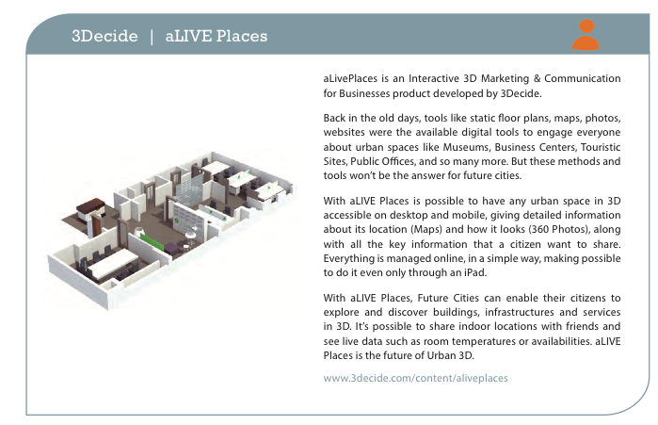
Case studies

Slide 112

Case studies

Slide 113
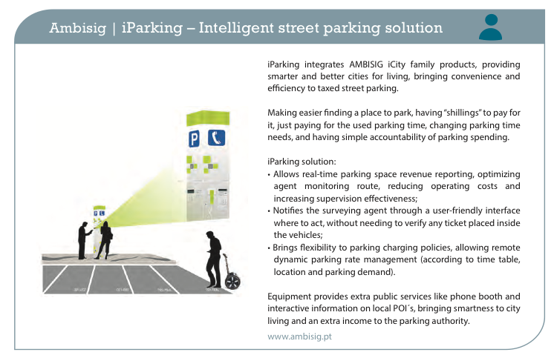
Case studies

Slide 114

Case studies

Slide 115
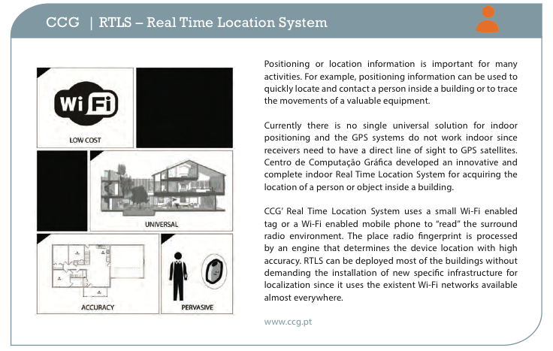
Case studies

Slide 116

Case studies

Slide 117
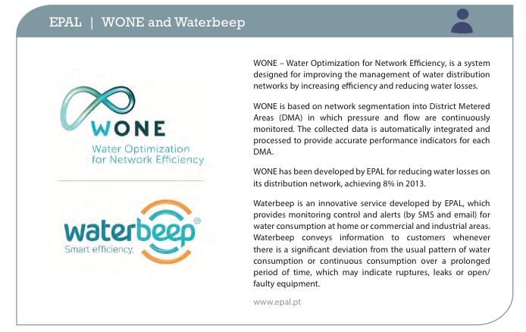
Case studies
f

Slide 118
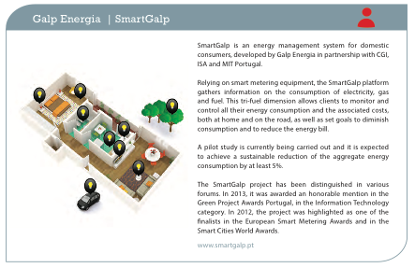
Case studies

Slide 119
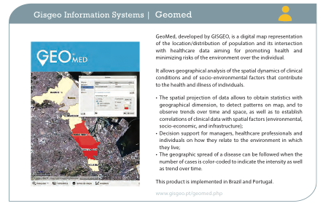
Case studies

Slide 120
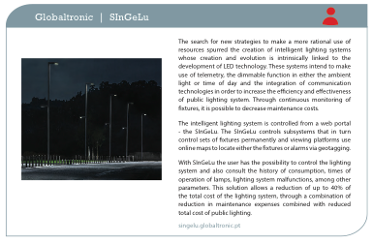
Case studies

Slide 121
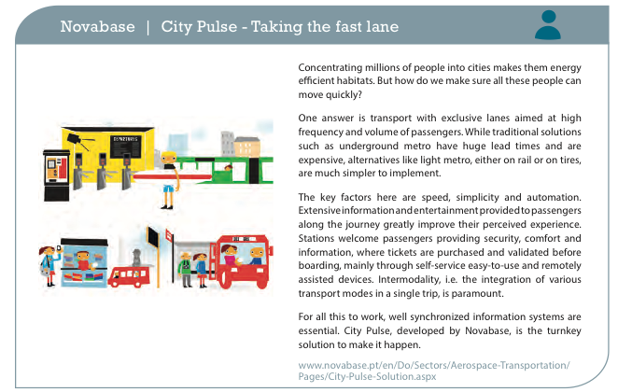
Case studies

Slide 122
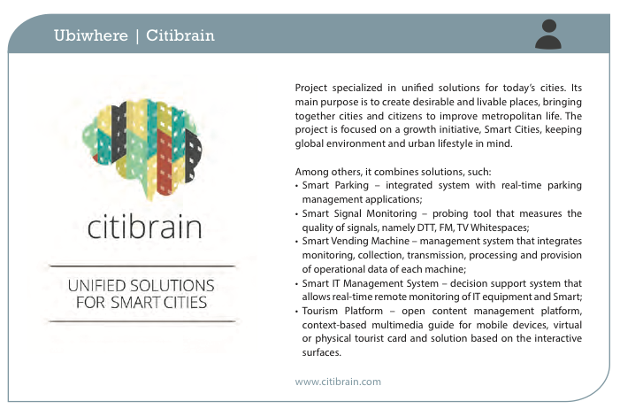
Case studies

Slide 123
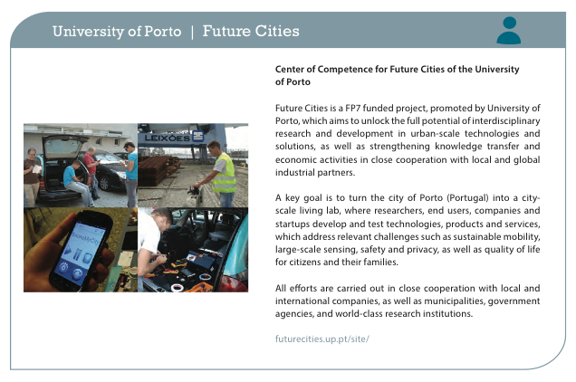
Case studies

Slide 125

Thanks!
Morada: Campus de Campolide, 1070-312 Lisboa, Portugal
Tel: +351 213 828 610 | Fax: +351 213 828 611

